Slide 1
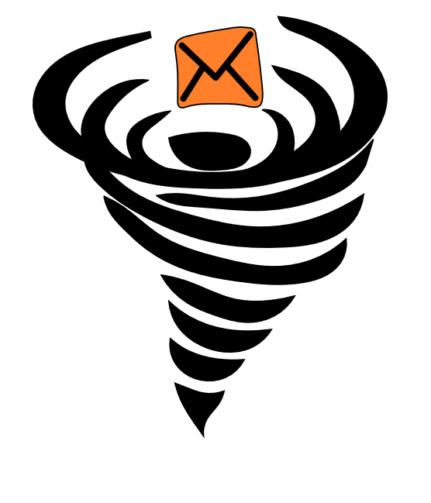
MessageVortex
Unlinkable, censorship-resistant communication

Slide 2
Anonymity matters in Censored environments
Achieving anonymity is hard
Many attempts such as remailers, mix nets, DC-nets, distributed hash tables (DHT), or broadcast based networks exist
Achieving anonymity in a censored environment is far harder
Few attempts exist (e.g., ToR, Riffle, or SCION)
All actively used technologies are censored

Slide 3
Content
Predecessor Systems
Anonymity Technologies
What are the problems?
MessageVortex
Why do we need it
What are the problems
How does it work
The General Idea
The Message
The Peer Key
The Sender Key
The Header
eID
Workspace
The Operations
Processing
Routing Strategies
What are its benefits
Any Questions Left?

Slide 4
Predecessor Systems
Remailers (0-III)
Nym Remailers
Cypherpunk
Mixmaster
Mixminion
Onion Routing (SOR, Tor, I2P…)
DHT (Salsa, Tarzan,…)
DC-Nets (Herbivore, Dissent)
Broadcast (Hordes)
Distributed Storages (Freenet,Guntella(2))

Slide 5
Technologies for Anonymity
Distribute data
Across multiple nodes
Hide data
Steganography
Mimicking of traffic (content and size wise)
Side channel transmission
Outcurve censorship measurements
Use modified TCP stacks
Use UDP

Slide 6
What are the Problems?
Technology
A (network) packet is always visible…
everyone may see it.
everyone may analyze it.
everyone may forward(modified or unmodified) or keep it.
If we distribute data, we need to recover enough parts.
It is relatively easy to build something for the lab but most of the approaches (e.g., broadcast based) do not scale.
Juristic
Every jurisdiction applies their own laws
Laws may disagree with each other

Slide 7
MessageVortex Why do we need it?
Anonymity is essential
Without anonymity there is no freedom of speech
Censoring (in general and of Anonymity technology) happens today
China (blocks Tor, calculate citizen score)
Turkey (VPNs banned, Websites censored)
United Arab Emirates (VPN is illegal for illegal activities ;-))
Iran (Only Government approved VPNs are legal)
Egypt (Website censorship, working on banning VPNs)
And more … (Bahrain, Ethiopia…)
This is not necessarily (officially) used for censorship. It is to…
fight „terrorism.“
fight „state decomposing elements.“
stopping “immoral or anti-religious works.”
Agreement: Censorship exists‘
its use may be questionable

Slide 8
MessageVortex general weak spots of anonymization solutions
Identifiable sets for senders and receivers
Identifiable infrastructure
Nodes in general
Entry nodes
Exit nodes
Central elements in infrastructure
Directory servers
Not prone to active adversaries
Identifiable (censorable) protocols
(Limited) trust in infrastructure
Identifiable meta data (e.g., message sizes, throughput, long living pseudonymity, or shrinking member sets)
Identifiable messages
Replayable routing information
Bugable protocols/Message content
Tagable protocols/Message content
Bootstrapping problem (e.g., key trust or key distribution problem)
Identification problem
Huge traffic overhead
… and many more …
Anonymization infrastructure
Sender
Receiver
aRouter
aRouter
Sender
Receiver
Sender
aRouter
aRouter
Receiver
Sender
Receiver
aRouter
aRouter
Sender
Sender
Receiver
Sender
aRouter
aRouter

Slide 9
How does it work The general idea
Messages are sent from node to node in a mix type like system
Send anonymous messages across the internet
A network built without dedicated infrastructure. Instead using always connected devices of end-users using common transport protocols.
Unobservable from the outside
Holistic approach piggybacking common protocols (e.g., SMTP, XMPP)
Distrust everyone (…)
Routing nodes learn as little as possible from routing a message
The routing process is controlled by the builder of the routing block in the message
The routing path is diagnoseable by the builder of the routing block
Our only trust: initial sender of the message and final recipient of the message
Decoy traffic is not even identifiable for the node generating or routing.
Resistant to common attacks which are hard to cover

Slide 10
How does it work The general idea (2; Functioning)
Each node gets a couple of payload blocks
It recombines available payload blocks
Payload block of any message from the same sender (short term pseudonym)
Outcome may be bigger or smaller depending on the applied operation:
Split or merge block
Encrypt or decrypt block
Add or remove redundancy information
Any payload block may be decoy or true message content!
Even the routing node generating decoy cannot tell decoy from message traffic apart.
Broken (crypto) algorithms must not break the protocol
Any type of operation should have an alternative

Slide 11
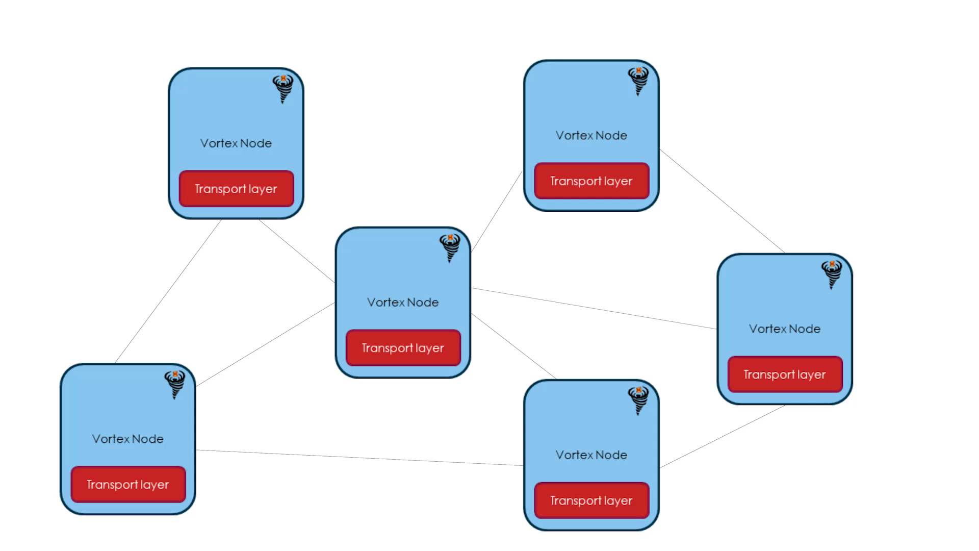
MessageVortex How does it work?
Nodes send and mix messages
All equal
All may be endpoint of a message
All do routing
Hide their traffic in common transport protocols
Messages
Purely controlled by an onionized routing block
Not identifiable unless you possess a node specific key
Always connected end-user device (e.g., mobile phone)
Any Transport layer infrastructure (e.g., Gmail account)

Slide 12


MessageVortex How does a message look like (on the transport layer)?
Dear sir
This is an obviously machine generated text with some images. May be a password recovery request, a routing graph, or any other kind of machine generated information.
Yours
MessageVortex
Extract
(e.g., „F5“ or similar steganographic algorithm)

Slide 13
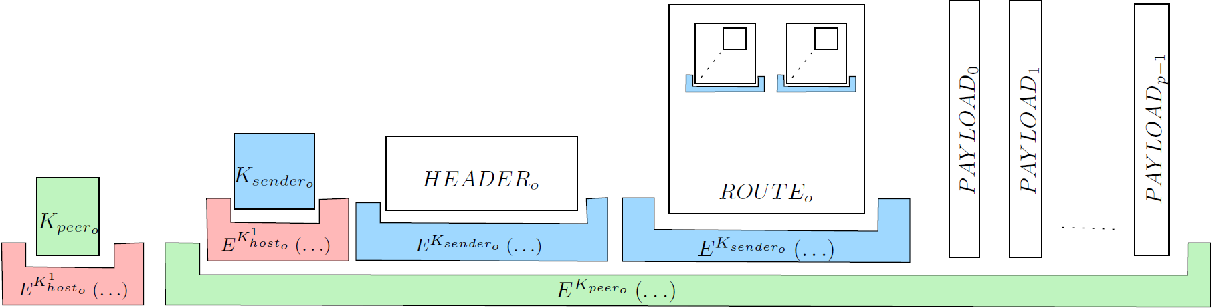
MessageVortex How does a message look like?
The encrypted sender key
The sender key protects the vital blocks.
The encrypted peer key
One to many message payloads (parts of the message or decoy)
The peer key protects the „inner message“
Header block „identifying“ the sender and containing requests (short term pseudonym).
Onionized routing blocks containing information on how to route and mix the message

Slide 14


MessageVortex The peer key
Important side note: The sending node does not(need to) have the receiving nodes public key
The peer key was also included in the message build instructions (in the routing block) of the sending node
The peer key is encrypted with the receiving nodes public key
Reminder: The peer key protects what we call the inner message
The peer key is only known to the two peering partners and the RBB
(sending) VortexNode
(other) VortexNode
Transport layer
Transport layer
VortexNode
(receiving) VortexNode
The RBB is the creator of the routing block
Transport layer
Transport layer
Routing Block Builder (RBB)

Slide 15
MessageVortex The sender key
The sender key is encrypted with the receiving nodes‘ public key.
Reminder: The sender key protects the header and the routing block additionally. Otherwise, the sending peer would know its content.
The sender key is only known to the receiving node and the RBB.
(sending) VortexNode
(other) VortexNode
Transport layer
Transport layer
VortexNode
(receiving) VortexNode
Transport layer
Transport layer
Routing Block Builder (RBB)

Slide 16
MessageVortex The Header
Contains:
An „ephemeral ID“ (eID; public key; synonymous to the sender)
A serial (allows replay protection)
Validity interval
May contain:
Requests (and the reply block)
Proof of work (if requesting something)
Important: All eIDs sign their header blocks with their private key.

Slide 17
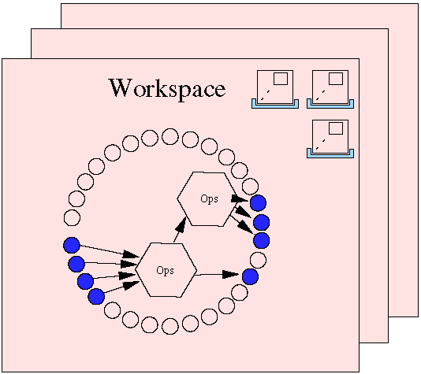
MessageVortex What is an eID? What is a workspace?
An eID is a short term synonym for the sender.
A sender must request eIDs on each node (with a request) before sending messages with a payload.
A sender may require solving a crypto puzzle to get an eID.
An eID enables a sender to have a temporary, exclusively assigned storage on the node called „workspace“.
Each eID has a quota assigned.
The maximum number of inbound messages with a payload.
The maximum number of outbound bytes of messages with a payload.
A workspace is…
For one eID
Contains
Routing blocks/combos
Operations
Payload blocks (referenced by IDs)

Slide 18
MessageVortex What are the available operations?
Each operation is defined by input Ids and output Ids.
We have three types of operations (always a tuple):
Split/Merge a payload
Encrypt/Decrypt a payload
addRedundancy and removeRedundancy
Pay
Payload
S
load
M
Payload
Payload
E
„&+/WSGJ
D
Payload
Payload
R
M e a u P o
R⁻¹
Payload
o n s a a
r t t y d
e r h j l
This is where the magic happens

Slide 19
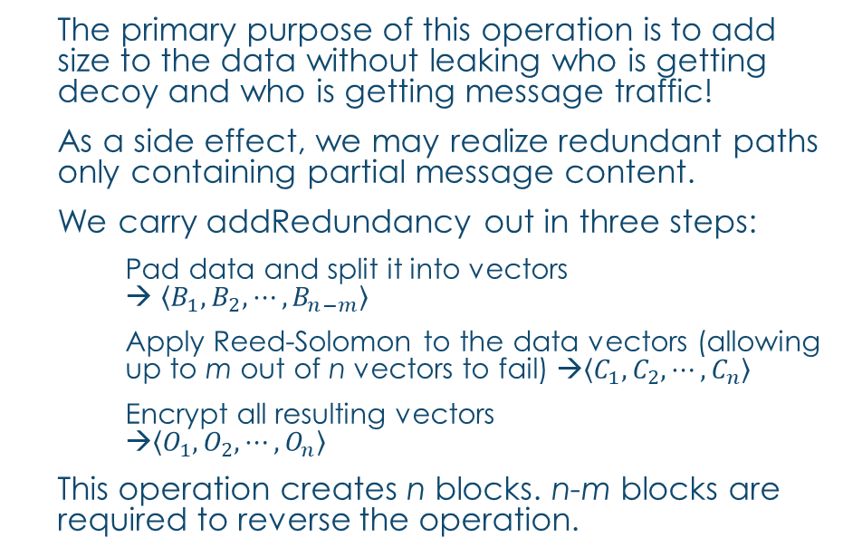
MessageVortex The addRedundancy operation (1)
The primary purpose of this operation is to add size to the data without leaking who is getting decoy and who is getting message traffic!
As a side effect, we may realize redundant paths only containing partial message content.
We carry addRedundancy out in three steps:
Pad data and split it into vectors → $\left\langle B_{1}, B_{2}, ⋯, B_{n−m}\right\rangle$
Apply Reed-Solomon to the data vectors (allowing up to m out of n vectors to fail) →$\left\langle C_{1}, C_{2}, ⋯, C_{n}\right\rangle$
Encrypt all resulting vectors →$\left\langle O_{1}, O_{2}, ⋯, O_{n}\right\rangle$
This operation creates n blocks. n-m blocks are required to reverse the operation.

Slide 20
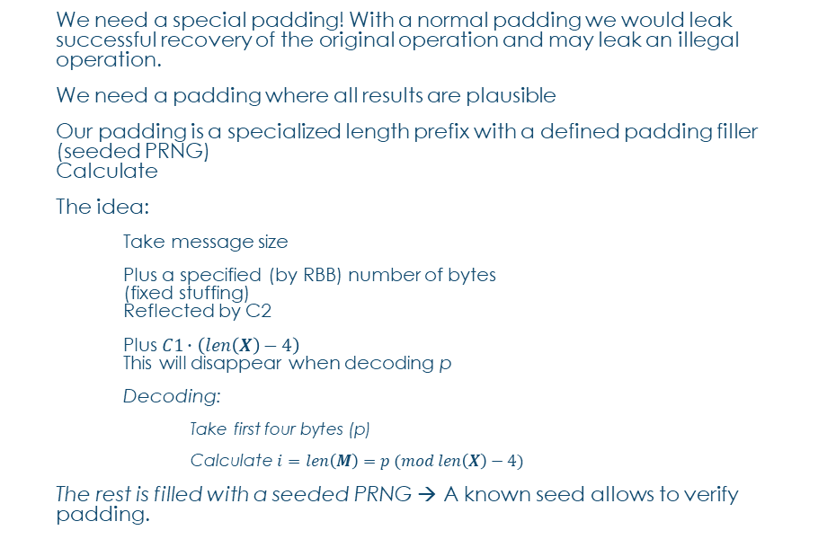

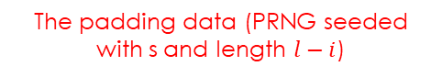
MessageVortex The addRedundancy operation (2)
We need a special padding! With a normal padding we would leak successful recovery of the original operation and may leak an illegal operation.
We need a padding where all results are plausible
Our padding is a specialized length prefix with a defined padding filler (seeded PRNG) Calculate
The idea:
Take message size
Plus a specified (by RBB) number of bytes (fixed stuffing) Reflected by C2
Plus $C1∙\left(len\left(X\right)−4\right)$ This will disappear when decoding p
Decoding:
Take first four bytes (p)
Calculate $i=len\left(M\right)=p (mod len\left(X\right)−4)$
The rest is filled with a seeded PRNG → A known seed allows to verify padding.
$$i=len\left(M\right)$$
$$e=blocksize\left(E^{K}\right)∙n$$
$$l= \left\lceil \frac{i+C2}{e}\right\rceil ∙e$$
$$p=i+ \left(C1∙l \left(mod \left\lfloor \frac{2^{32}−1−i}{l}\right\rfloor ∙l\right)\right)$$
$$X= \left\langle p,M, R\left(s,l−i\right)\right\rangle$$
The padded message
The padding value (length; 4 Bytes unint)
The padding data (PRNG seeded with s and length $l−i$)
The message

Slide 21

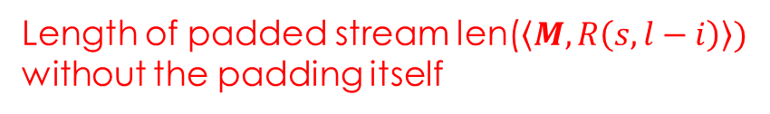
MessageVortex The addRedundancy operation (3)
$$i=len\left(M\right)$$
$$e=blocksize\left(E^{K}\right)∙n$$
$$l= \left\lceil \frac{i+C2}{e}\right\rceil ∙e$$
$$p=i+ \left(C1∙l \left(mod \left\lfloor \frac{2^{32}−1−i}{l}\right\rfloor ∙l\right)\right)$$
$$X = \left\langle p,M, R\left(s,l−i\right)\right\rangle$$
$=\left\langle p,M, R\left(s,l−(p mod (len(X)−4\right))\right\rangle$
The length of the original message
Block size of the operation (dependent on the number of stripes and the cipher block size)
Length of padded stream len($\left\langle M, R\left(s,l−i\right)\right\rangle )$ without the padding itself

Slide 22

MessageVortex The addRedundancy operation (3)
$$i=len\left(M\right) \\ e=blocksize\left(E^{K}\right)∙n \\ l= \left\lceil \frac{i+C2}{e}\right\rceil ∙e \\ p=i+ \left(C1∙l \left(mod \left\lfloor \frac{2^{32}−1−i}{l}\right\rfloor ∙l\right)\right) \\ X= \left\langle p,M, R\left(s,l−i\right)\right\rangle \\ =\left\langle p,M, R\left(s,l−(p mod (len(X)−4)\right)\right\rangle$$
C2 is a fixed value of bytes to be added to the message. By adding C2, we make it possible, that value p<=len(X)-4 is valid.
C1 is a generator for multiples of l and guarantees that any p>len(X)-4 is valid as well.
We require C1 and C2 when decoding only for verifying the padding value. We do NOT require the values for successful decoding.

Slide 23
MessageVortex The addRedundancy operation (4)
Up until now we have padded the message with the following properties:
The message has a perfect length to allow:
Apply the Read-Solomon operation without further padding
Apply the encryption without further padding
→ Let‘s apply Reed-Solomon
Interlude: Reed Solomon (RS) is a code used typically for error correction. It adds a constant but selectable error correction information to the data, allowing m out of n data chunks to fail.
In the real world, RS is typically used in a stripped manner in RAID6 systems to allow multiple disks to fail without losing data.

Slide 24
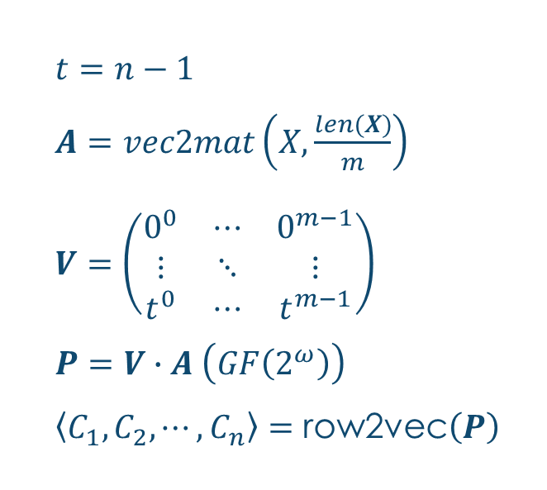
MessageVortex The addRedundancy operation (5)
$t=n−1$
$A=vec2mat\left(X,\frac{len(X)}{m}\right)$
$V=\left(\begin{matrix}0^{0} & ⋯ & 0^{m−1} \\ ⋮ & ⋱ & ⋮ \\ t^{0} & ⋯ & t^{m−1}\end{matrix}\right)$
$P=V∙A \left(GF\left(2^{ω}\right)\right)$
$\left\langle C_{1}, C_{2}, ⋯, C_{n}\right\rangle =\text{row}\text{2}\text{ve}\text{c}\left(P\right)$
We allign the padded data in a matrix
We prepare a suitable Vandermonde matrix (m rows and n colums)
We apply RS The result is a matrix with the message and added redundancy information.
We extract the rows as vector

Slide 25
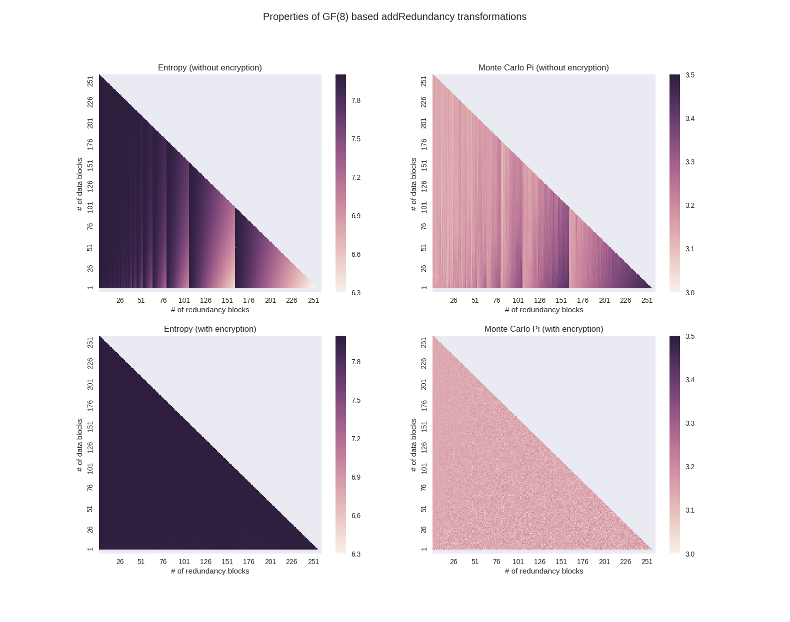
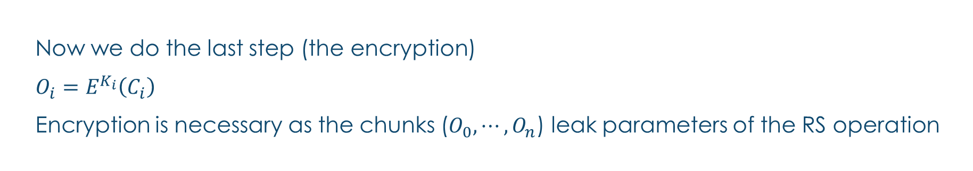
MessageVortex The addRedundancy operation (5)
Now we do the last step (the encryption)
$O_{i}=E^{K_{i}}\left(C_{i}\right)$
Encryption is necessary as the chunks ($O_{0},⋯, O_{n}$) leak parameters of the RS operation
Entropy and Monte Carlo PI without encryption with varying parameters on the same block WITHOUT encryption
Entropy and Monte Carlo PI without encryption with varying parameters on the same block WITH encryption

Slide 26
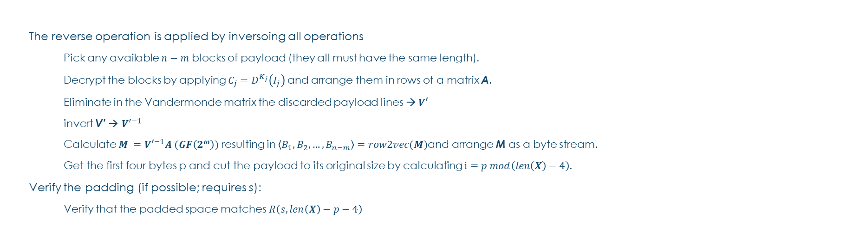

MessageVortex The addRedundancy operation (6)
$$X= \left\langle p,M, R\left(s,p mod (len(X)−4\right)\right\rangle$$
The reverse operation is applied by inversoing all operations
Pick any available $n−m$ blocks of payload (they all must have the same length).
Decrypt the blocks by applying $C_{j}=D^{K_{j}}\left(I_{j}\right)$ and arrange them in rows of a matrix A.
Eliminate in the Vandermonde matrix the discarded payload lines → $V′$
invert V’ → ${V′}^{−1}$
Calculate $M ={V′}^{−1}A (GF\left(2^{ω}\right))$ resulting in $\left\langle B_{1}, B_{2}, …, B_{n−m}\right\rangle =row2vec(M)$and arrange M as a byte stream.
Get the first four bytes p and cut the payload to its original size by calculating $i=p mod\left(len\left(X\right)−4\right)$.
Verify the padding (if possible; requires s):
Verify that the padded space matches $R\left(s,len\left(X\right)−p−4\right)$

Slide 27
MessageVortex Processing an incoming message
Dear sir
This is an obviously machine generated text with some images. May be a password recovery request, a routing graph, or any other kind of machine generated information.
Yours
MessageVortex
Extract message by the blending layer
Extract message prefix block and decrypt it.
If a valid structure with a peer key is provided continue with the inner message by decrypting with the key provided in the prefix block.
Get sender key and decrypt header, and routing block
Verify signature of header and rules for processing
Process header requests (if applicable)
Apply mapping operations for IDs 1 up to 127 into workspace (mapping of payload blocks into the workspace)
Add operations to the workspace
Add routing combos to the workspace
If a message is written to payload ID 0 then this message is for the local user

Slide 28
MessageVortex Processing an incoming message
Extract message by the blending layer
Extract message prefix block and decrypt it.
If a valid structure with a peer key is provided continue with the inner message by decrypting with the key provided in the prefix block.
Get sender key and decrypt header, and routing block
Verify signature of header and rules for processing
Process header requests (if applicable)
Apply mapping operations for IDs 1 up to 127 into workspace (mapping of payload blocks into the workspace)
Add operations to the workspace
If a message is written to payload ID 0 then this message is for the local user
Add routing combos to the workspace
If a message is written to payload ID 0 then this message is for the local user

Slide 29
MessageVortex Processing an incoming message
Extract message by the blending layer
Extract message prefix block and decrypt it.
If a valid structure with a peer key is provided continue with the inner message by decrypting with the key provided in the prefix block.
Get sender key and decrypt header, and routing block
Verify signature of header and rules for processing
Process header requests (if applicable)
Apply mapping operations for IDs 1 up to 127 into workspace (mapping of payload blocks into the workspace)
Add operations to the workspace
If a message is written to payload ID 0 then this message is for the local user
Add routing combos to the workspace

Slide 30
MessageVortex Processing an incoming message
Extract message by the blending layer
Extract message prefix block and decrypt it.
If a valid structure with a peer key is provided continue with the inner message by decrypting with the key provided in the prefix block.
Get sender key and decrypt header, and routing block
Verify signature of header and rules for processing
Process header requests (if applicable)
Apply mapping operations for IDs 1 up to 127 into workspace (mapping of payload blocks into the workspace)
Add operations to the workspace
If a message is written to payload ID 0 then this message is for the local user
Add routing combos to the workspace
Verify state of eID
Extract Serial and do replay checks

Slide 31
MessageVortex Processing an incoming message
Extract message by the blending layer
Extract message prefix block and decrypt it.
If a valid structure with a peer key is provided continue with the inner message by decrypting with the key provided in the prefix block.
Get sender key and decrypt header, and routing block
Verify signature of header and rules for processing
Process header requests (if applicable)
Apply mapping operations for IDs 1 up to 127 into workspace (mapping of payload blocks into the workspace)
Add operations to the workspace
If a message is written to payload ID 0 then this message is for the local user
Add routing combos to the workspace
Process header requests:
Create new eID
Get node capabilities
Get quotas
Increase quotas
Request routing nodes
Replace identity
PoW or anonymous payment may apply

Slide 32
MessageVortex Processing an incoming message
Extract message by the blending layer
Extract message prefix block and decrypt it.
If a valid structure with a peer key is provided continue with the inner message by decrypting with the key provided in the prefix block.
Get sender key and decrypt header, and routing block
Verify signature of header and rules for processing
Process header requests (if applicable)
Apply mapping operations for IDs 1 up to 127 into workspace (mapping of payload blocks into the workspace)
Add operations to the workspace
If a message is written to payload ID 0 then this message is for the local user
Add routing combos to the workspace

Slide 33
MessageVortex Processing an incoming message
Extract message by the blending layer
Extract message prefix block and decrypt it.
If a valid structure with a peer key is provided continue with the inner message by decrypting with the key provided in the prefix block.
Get sender key and decrypt header, and routing block
Verify signature of header and rules for processing
Process header requests (if applicable)
Apply mapping operations for IDs 1 up to 127 into workspace (mapping of payload blocks into the workspace)
Add operations to the workspace
If a message is written to payload ID 0 then this message is for the local user
Add routing combos to the workspace

Slide 34
MessageVortex Processing an incoming message
Extract message by the blending layer
Extract message prefix block and decrypt it.
If a valid structure with a peer key is provided continue with the inner message by decrypting with the key provided in the prefix block.
Get sender key and decrypt header, and routing block
Verify signature of header and rules for processing
Process header requests (if applicable)
Apply mapping operations for IDs 1 up to 127 into workspace (mapping of payload blocks into the workspace)
Add operations to the workspace
If a message is written to payload ID 0 then this message is for the local user
Add routing combos to the workspace

Slide 35
MessageVortex Processing an outgoing message
Triggered by the timing information in the routing combo
Assemble the payload blocks by applying the operations provided. If done execute the mapping to the IDs 1-127
Add routing block, prefix blocks (containing the sender and peer keys), and the header block to the message (all blocks are provided as preencrypted binary blobs)
Encrypt inner message
Apply blending according to spec in the routing combo.
Send message by using the transport layer.

Slide 36
MessageVortex routing diagnosis
Possible by routing parts of the message back to the originator.
As all operations are known the resulting payload blocks are foreseeable.
If traffic is illicit, additional messages picking up more parts from other workspaces may be injected to narrow down diagnosis of misbehaving nodes
Successful message delivery may be tracked by routing parts of the message from the recipients node back to the sender (directly or indirectly).

Slide 37
MessageVortex Routing Strategies (general)
In General:
Use addRedundancy to add decoy
Use either encrypt or decrypt to (de)onionize
Use Split and merge to join/distribute traffic (requires onionizing or addRedundancy step)

Slide 38
MessageVortex Routing Strategies (specific)
Creating decoy traffic
Use addRedundancy to add decoy
Same restrictions apply as if sending a message part
Removing decoy traffic
Do not do anything with a payload block
For the node this looks as:
Decoy
Redundant traffic not picked up
Diagnosis traffic not handled
Malfunctioning path
Sending received decoy traffic
Same as sending a message part
Sending a message part
Split and encrypt
Join and encrypt
Encrypt only (may be decrypt only as well; Use with caution)
addRedundancy
May include additional split or join
NO reocurrence of data
No forwarding of data without at least one encryption step involved
No reverse operations anywhere on untrusted nodes

Slide 39
MessageVortex A simple Strategy for building a routing block
Choose VortexNodes and allocate eIDs if required
Choose a directed suitable graph (Nodes=VortexNodes; Edges=Messages).
Select path(s) for message transferal to final recipient.
Select operations
For the message
For the decoy traffic
Select timing information for the blocks.
Assemble routing block (it is always one at the beginning).
Apply routing block to message and hand it over to the router (local)

Slide 40
MessageVortex Where do I get my peer partners from?
In a censoring environment
You need to collect them yourself (manually)
In a non censoring environment (where usage of MessageVortex is no problem)
Query the nodes directly with a capability request (HeaderRequestCapability)
Ask a node to recover public routing nodes (HeaderRequestNodes)

Slide 41
MessageVortex A What are its benefits?
The first holistic approach targeting the needs of a partially/fully censoring environment
Bases on proven technology
Reed-Solomon operations are well known
Mixing (and its limitations) are well known
Is Cryptoagile
Allows diagnosis
Allows local trust
Gives full control of all privacy related parameters to the builder of the routing block.
Contributes
A new padding type not leaking any information about successful decryption.
An addRedundancy operation allowing to add redundancy and or decoy traffic without letting the routing node the type of data know.

Slide 42

Questions?

Slide 43
Addon SLides

Slide 44
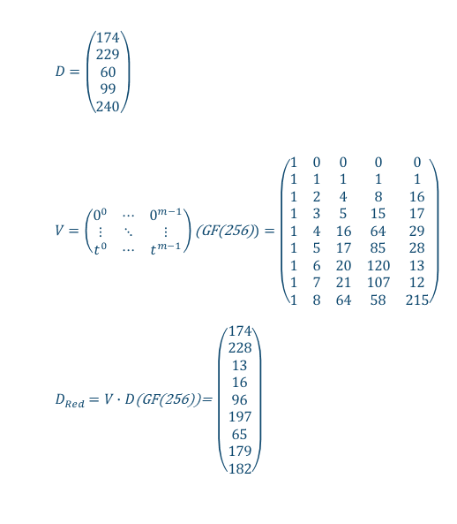
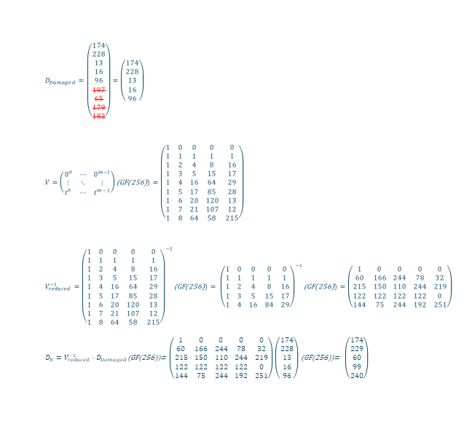
the RS-Operation
Adding redundancy information
Lo(u/s)sy transmission
Recovering data
$D_{Damaged}=\left(\begin{matrix}174 \\ 228 \\ 13 \\ 16 \\ 96 \\ 197 \\ 65 \\ 179 \\ 182\end{matrix}\right)=\left(\begin{matrix}174 \\ 228 \\ 13 \\ 16 \\ 96\end{matrix}\right)$
$V=\left(\begin{matrix}0^{0} & ⋯ & 0^{m−1} \\ ⋮ & ⋱ & ⋮ \\ t^{0} & ⋯ & t^{m−1}\end{matrix}\right)\text{(}\text{GF}\text{(256)})=\left(\begin{matrix}1 & 0 & 0 & 0 & 0 \\ 1 & 1 & 1 & 1 & 1 \\ 1 & 2 & 4 & 8 & 16 \\ 1 & 3 & 5 & 15 & 17 \\ 1 & 4 & 16 & 64 & 29 \\ 1 & 5 & 17 & 85 & 28 \\ 1 & 6 & 20 & 120 & 13 \\ 1 & 7 & 21 & 107 & 12 \\ 1 & 8 & 64 & 58 & 215\end{matrix}\right)$
$V_{reduced}^{−1}={\left(\begin{matrix}1 & 0 & 0 & 0 & 0 \\ 1 & 1 & 1 & 1 & 1 \\ 1 & 2 & 4 & 8 & 16 \\ 1 & 3 & 5 & 15 & 17 \\ 1 & 4 & 16 & 64 & 29 \\ 1 & 5 & 17 & 85 & 28 \\ 1 & 6 & 20 & 120 & 13 \\ 1 & 7 & 21 & 107 & 12 \\ 1 & 8 & 64 & 58 & 215\end{matrix}\right)}^{−1}\text{(}\text{GF}\text{(256)})= {\left(\begin{matrix}1 & 0 & 0 & 0 & 0 \\ 1 & 1 & 1 & 1 & 1 \\ 1 & 2 & 4 & 8 & 16 \\ 1 & 3 & 5 & 15 & 17 \\ 1 & 4 & 16 & 84 & 29\end{matrix}\right)}^{−1}\text{(}\text{GF}\text{(256)})=\left(\begin{matrix}1 & 0 & 0 & 0 & 0 \\ 60 & 166 & 244 & 78 & 32 \\ 215 & 150 & 110 & 244 & 219 \\ 122 & 122 & 122 & 122 & 0 \\ 144 & 75 & 244 & 192 & 251\end{matrix}\right)$
$D_{R}=V_{reduced}^{−1}∙D_{Damaged}$(GF(256))= $\left(\begin{matrix}1 & 0 & 0 & 0 & 0 \\ 60 & 166 & 244 & 78 & 32 \\ 215 & 150 & 110 & 244 & 219 \\ 122 & 122 & 122 & 122 & 0 \\ 144 & 75 & 244 & 192 & 251\end{matrix}\right)\left(\begin{matrix}174 \\ 228 \\ 13 \\ 16 \\ 96\end{matrix}\right)$ (GF(256))= $\left(\begin{matrix}174 \\ 229 \\ 60 \\ 99 \\ 240\end{matrix}\right)$
$D=\left(\begin{matrix}174 \\ 229 \\ 60 \\ 99 \\ 240\end{matrix}\right)$
$V=\left(\begin{matrix}0^{0} & ⋯ & 0^{m−1} \\ ⋮ & ⋱ & ⋮ \\ t^{0} & ⋯ & t^{m−1}\end{matrix}\right)\text{(}\text{GF}\text{(256)})=\left(\begin{matrix}1 & 0 & 0 & 0 & 0 \\ 1 & 1 & 1 & 1 & 1 \\ 1 & 2 & 4 & 8 & 16 \\ 1 & 3 & 5 & 15 & 17 \\ 1 & 4 & 16 & 64 & 29 \\ 1 & 5 & 17 & 85 & 28 \\ 1 & 6 & 20 & 120 & 13 \\ 1 & 7 & 21 & 107 & 12 \\ 1 & 8 & 64 & 58 & 215\end{matrix}\right)$
$D_{Red}=V∙D$(GF(256))= $\left(\begin{matrix}174 \\ 228 \\ 13 \\ 16 \\ 96 \\ 197 \\ 65 \\ 179 \\ 182\end{matrix}\right)$

Slide 45
GF-Log Table
omega=8
Add:xor; sub=xor;
mul=iif (c1 == 0 || c2 == 0;0; gfilog[gfLog[c1] + gfLog[c2]-iif(gfLog[c1] + gfLog[c2]>2^8-1;2^"+omega+"-1;0)]
div=iif (c1 == 0;0;iif(c2==0;illegal;gfilog[gfLog[c1] - gfLog[c2]+iif(gfLog[c1] - gfLog[c2]<>0;2^"+omega+"-1;0))]
| num | log |ilog | | num | log |ilog | | num | log |ilog | | num | log |ilog | | num | log |ilog | | num | log |ilog | | num | log |ilog | | num | log |ilog |
+-----+-----+-----+ +-----+-----+-----+ +-----+-----+-----+ +-----+-----+-----+ +-----+-----+-----+ +-----+-----+-----+ +-----+-----+-----+ +-----+-----+-----+
| 0 | -1 | 1 | | 32 | 5 | 157 | | 64 | 6 | 95 | | 96 | 30 | 217 | | 128 | 7 | 133 | | 160 | 55 | 230 | | 192 | 31 | 130 | | 224 | 203 | 18 |
| 1 | 0 | 2 | | 33 | 138 | 39 | | 65 | 191 | 190 | | 97 | 66 | 175 | | 129 | 112 | 23 | | 161 | 63 | 209 | | 193 | 45 | 25 | | 225 | 89 | 36 |
| 2 | 1 | 4 | | 34 | 101 | 78 | | 66 | 139 | 97 | | 98 | 182 | 67 | | 130 | 192 | 46 | | 162 | 209 | 191 | | 194 | 67 | 50 | | 226 | 95 | 72 |
| 3 | 25 | 8 | | 35 | 47 | 156 | | 67 | 98 | 194 | | 99 | 163 | 134 | | 131 | 247 | 92 | | 163 | 91 | 99 | | 195 | 216 | 100 | | 227 | 176 | 144 |
| 4 | 2 | 16 | | 36 | 225 | 37 | | 68 | 102 | 153 | | 100 | 195 | 17 | | 132 | 140 | 184 | | 164 | 149 | 198 | | 196 | 183 | 200 | | 228 | 156 | 61 |
| 5 | 50 | 32 | | 37 | 36 | 74 | | 69 | 221 | 47 | | 101 | 72 | 34 | | 133 | 128 | 109 | | 165 | 188 | 145 | | 197 | 123 | 141 | | 229 | 169 | 122 |
| 6 | 26 | 64 | | 38 | 15 | 148 | | 70 | 48 | 94 | | 102 | 126 | 68 | | 134 | 99 | 218 | | 166 | 207 | 63 | | 198 | 164 | 7 | | 230 | 160 | 244 |
| 7 | 198 | 128 | | 39 | 33 | 53 | | 71 | 253 | 188 | | 103 | 110 | 136 | | 135 | 13 | 169 | | 167 | 205 | 126 | | 199 | 118 | 14 | | 231 | 81 | 245 |
| 8 | 3 | 29 | | 40 | 53 | 106 | | 72 | 226 | 101 | | 104 | 107 | 13 | | 136 | 103 | 79 | | 168 | 144 | 252 | | 200 | 196 | 28 | | 232 | 11 | 247 |
| 9 | 223 | 58 | | 41 | 147 | 212 | | 73 | 152 | 202 | | 105 | 58 | 26 | | 137 | 74 | 158 | | 169 | 135 | 229 | | 201 | 23 | 56 | | 233 | 245 | 243 |
| 10 | 51 | 116 | | 42 | 142 | 181 | | 74 | 37 | 137 | | 106 | 40 | 52 | | 138 | 222 | 33 | | 170 | 151 | 215 | | 202 | 73 | 112 | | 234 | 22 | 251 |
| 11 | 238 | 232 | | 43 | 218 | 119 | | 75 | 179 | 15 | | 107 | 84 | 104 | | 139 | 237 | 66 | | 171 | 178 | 179 | | 203 | 236 | 224 | | 235 | 235 | 235 |
| 12 | 27 | 205 | | 44 | 240 | 238 | | 76 | 16 | 30 | | 108 | 250 | 208 | | 140 | 49 | 132 | | 172 | 220 | 123 | | 204 | 127 | 221 | | 236 | 122 | 203 |
| 13 | 104 | 135 | | 45 | 18 | 193 | | 77 | 145 | 60 | | 109 | 133 | 189 | | 141 | 197 | 21 | | 173 | 252 | 246 | | 205 | 12 | 167 | | 237 | 117 | 139 |
| 14 | 199 | 19 | | 46 | 130 | 159 | | 78 | 34 | 120 | | 110 | 186 | 103 | | 142 | 254 | 42 | | 174 | 190 | 241 | | 206 | 111 | 83 | | 238 | 44 | 11 |
| 15 | 75 | 38 | | 47 | 69 | 35 | | 79 | 136 | 240 | | 111 | 61 | 206 | | 143 | 24 | 84 | | 175 | 97 | 255 | | 207 | 246 | 166 | | 239 | 215 | 22 |
| 16 | 4 | 76 | | 48 | 29 | 70 | | 80 | 54 | 253 | | 112 | 202 | 129 | | 144 | 227 | 168 | | 176 | 242 | 227 | | 208 | 108 | 81 | | 240 | 79 | 44 |
| 17 | 100 | 152 | | 49 | 181 | 140 | | 81 | 208 | 231 | | 113 | 94 | 31 | | 145 | 165 | 77 | | 177 | 86 | 219 | | 209 | 161 | 162 | | 241 | 174 | 88 |
| 18 | 224 | 45 | | 50 | 194 | 5 | | 82 | 148 | 211 | | 114 | 155 | 62 | | 146 | 153 | 154 | | 178 | 211 | 171 | | 210 | 59 | 89 | | 242 | 213 | 176 |
| 19 | 14 | 90 | | 51 | 125 | 10 | | 83 | 206 | 187 | | 115 | 159 | 124 | | 147 | 119 | 41 | | 179 | 171 | 75 | | 211 | 82 | 178 | | 243 | 233 | 125 |
| 20 | 52 | 180 | | 52 | 106 | 20 | | 84 | 143 | 107 | | 116 | 10 | 248 | | 148 | 38 | 82 | | 180 | 20 | 150 | | 212 | 41 | 121 | | 244 | 230 | 250 |
| 21 | 141 | 117 | | 53 | 39 | 40 | | 85 | 150 | 214 | | 117 | 21 | 237 | | 149 | 184 | 164 | | 181 | 42 | 49 | | 213 | 157 | 242 | | 245 | 231 | 233 |
| 22 | 239 | 234 | | 54 | 249 | 80 | | 86 | 219 | 177 | | 118 | 121 | 199 | | 150 | 180 | 85 | | 182 | 93 | 98 | | 214 | 85 | 249 | | 246 | 173 | 207 |
| 23 | 129 | 201 | | 55 | 185 | 160 | | 87 | 189 | 127 | | 119 | 43 | 147 | | 151 | 124 | 170 | | 183 | 158 | 196 | | 215 | 170 | 239 | | 247 | 232 | 131 |
| 24 | 28 | 143 | | 56 | 201 | 93 | | 88 | 241 | 254 | | 120 | 78 | 59 | | 152 | 17 | 73 | | 184 | 132 | 149 | | 216 | 251 | 195 | | 248 | 116 | 27 |
| 25 | 193 | 3 | | 57 | 154 | 186 | | 89 | 210 | 225 | | 121 | 212 | 118 | | 153 | 68 | 146 | | 185 | 60 | 55 | | 217 | 96 | 155 | | 249 | 214 | 54 |
| 26 | 105 | 6 | | 58 | 9 | 105 | | 90 | 19 | 223 | | 122 | 229 | 236 | | 154 | 146 | 57 | | 186 | 57 | 110 | | 218 | 134 | 43 | | 250 | 244 | 108 |
| 27 | 248 | 12 | | 59 | 120 | 210 | | 91 | 92 | 163 | | 123 | 172 | 197 | | 155 | 217 | 114 | | 187 | 83 | 220 | | 219 | 177 | 86 | | 251 | 234 | 216 |
| 28 | 200 | 24 | | 60 | 77 | 185 | | 92 | 131 | 91 | | 124 | 115 | 151 | | 156 | 35 | 228 | | 188 | 71 | 165 | | 220 | 187 | 172 | | 252 | 168 | 173 |
| 29 | 8 | 48 | | 61 | 228 | 111 | | 93 | 56 | 182 | | 125 | 243 | 51 | | 157 | 32 | 213 | | 189 | 109 | 87 | | 221 | 204 | 69 | | 253 | 80 | 71 |
| 30 | 76 | 96 | | 62 | 114 | 222 | | 94 | 70 | 113 | | 126 | 167 | 102 | | 158 | 137 | 183 | | 190 | 65 | 174 | | 222 | 62 | 138 | | 254 | 88 | 142 |
| 31 | 113 | 192 | | 63 | 166 | 161 | | 95 | 64 | 226 | | 127 | 87 | 204 | | 159 | 46 | 115 | | 191 | 162 | 65 | | 223 | 90 | 9 | | 255 | 175 | -1 |

Slide 46
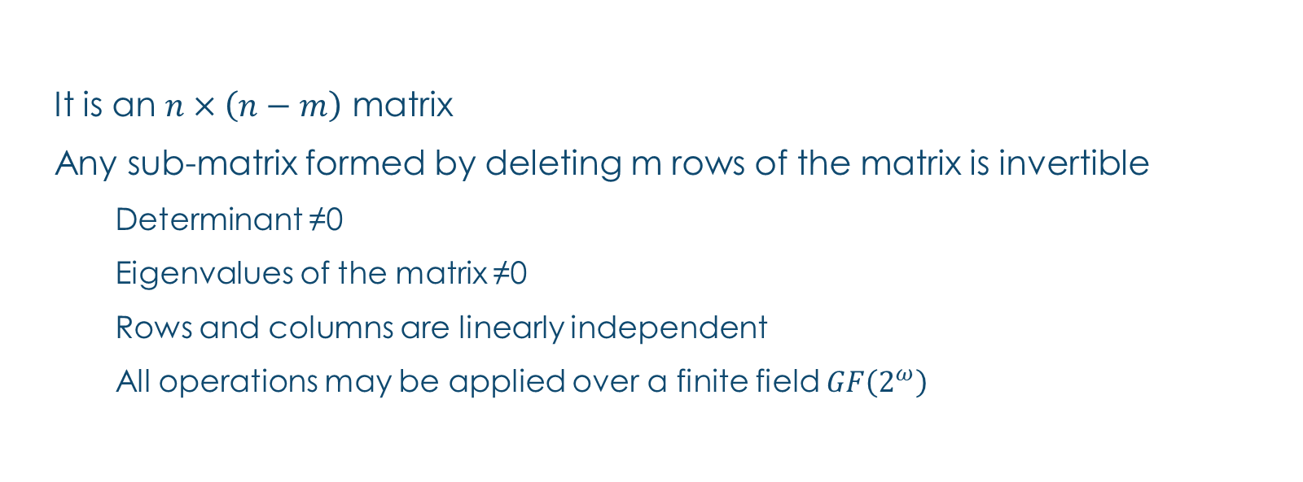
Properties for the Dispersal Matrix
It is an $n×\left(n−m\right)$ matrix
Any sub-matrix formed by deleting m rows of the matrix is invertible
Determinant ≠0
Eigenvalues of the matrix ≠0
Rows and columns are linearly independent
All operations may be applied over a finite field $GF\left(2^{ω}\right)$

Slide 47
Comparing MessageVortex MV (Mimicking) compared to a type-0 remailer
MessageVortex
+ Steganogragphically secured transport
+ Protocol agnostic
+ Unknown sending and receiving nodes
Only MV as endpoints
Higher complexity
Higher transport overhead
Type-0 Remailer
+ Simple implementation
Easily observable (no encryption and identical, observable content)
Requires internet infrastructure
Common
Anonymity breakable by remailer

Slide 48
Comparing MessageVortex MV (Mimicking) compared to a type-0 remailer (Nym)
MessageVortex
+ Steganogragphically secured transport
+ Protocol agnostic
+ unknown sending and receiving nodes
Higher complexity
Higher transport overhead
Type-0 Remailer
+ Simple implementation
+ No dedicated Transport protocol
Easily observable
Requires internet infrastructure
Common
+ No dedicated transport protocol
Anonymity breakable by router

Slide 49
Comparing MessageVortex MV (Mimicking) compared to a type-1 remailer (Cypherpunk)
MessageVortex
+ Steganogragphically secured transport
+ Protocol agnostic
+ unknown sending and receiving nodes
Only MV as endpoints
Higher complexity
Higher transport overhead
Type-1 Remailer
+ Simple implementation
+ No dedicated Transport protocol
+ Recipient may be any Email-Address
Easily observable
Requires internet infrastructure
Common
+ No dedicated anonymity protocol
Anonymity breakable by router

Slide 50
Comparing MessageVortex MV (Mimicking) compared to a type-2 remailer (Mixmaster)
MessageVortex
+ Steganogragphically secured transport
+ Protocol agnostic
+ Unobservable message size
+ unknown sending and receiving nodes
Higher complexity
Higher transport overhead
Type-2 Remailer
+ Simple implementation
+ Constant message size
+ No dedicated Transport protocol
Dedicated protocol
Requires internet infrastructure
Messages identifiable as PGP encrypted
Common
+ Multiple message paths possible for chunks

Slide 51
Comparing MessageVortex MV (Mimicking) compared to a type-3 remailer (Mixmaster)
MessageVortex
+ Steganogragphically secured transport
+ Protocol agnostic
+ Unobservable message size
+unknown sending and receiving nodes
Higher complexity
Higher transport overhead
Type-3 Remailer
+ Simple implementation
+ Constant message size
Dedicated protocol
Requires internet infrastructure
Common
+ Multiple message paths possible for chunks

Slide 52
Comparing MessageVortex MV compared to a DC-Network
MessageVortex
+ Steganogragphically secured transport
+ Protocol agnostic
+ Unobservable message size
Possibly higher transport overhead
DC-Network
+ Known weaknesses
Dedicated protocol
Requires internet infrastructure
Complex two way communication pattern (identifiable and pretty unique)
Message sizes/transfer volumes are typically known
Hard to secure against active adversaries
Requires typically an ideal broadcast

Slide 53
MessageVortex Block Header block
HeaderBlock ::= SEQUENCE {
-- Public key of the identity representing this
-- transmission
identityKey AsymmetricKey,
-- serial identifying this block
serial INTEGER (0..maxSerial),
-- number of times this block may be replayed
-- (Tuple is identityKey, serial while UsagePeriod
-- of block)
maxReplays INTEGER (0..maxNumberOfReplays),
-- subsequent Blocks are not processed before
-- valid time.
-- Host may reject too long retention. Recomended
-- validity support >=1Mt.
valid UsagePeriod,
-- represents the chained secret which has to be
-- found in subsequent blocks prevents reassembly
-- attack
forwardSecret ChainSecret,
-- contains the MAC-Algorithm used for signing
signAlgorithm MacAlgorithmSpec,
-- contains administrative requests such as quota
-- requests
requests SEQUENCE
(SIZE (0..maxNumberOfRequests))
OF HeaderRequest ,
-- Reply Block for the requests
requestReplyBlock RoutingCombo,
-- padding and identitifier required to solve the
-- cryptopuzzle
identifier [12201] PuzzleIdentifier OPTIONAL,
-- This is for solving crypto puzzles
proofOfWork [12202] OCTET STRING OPTIONAL
}

Slide 54
MessageVortex Block Routing Block
RoutingBlock ::= SEQUENCE {
-- contains the routingCombos
routing [331] SEQUENCE (SIZE (0..maxRoutingBlocks))
OF RoutingCombo,
-- contains the secret of the header block
forwardSecret ChainSecret,
-- contains the mapping operations to map payloads
-- to the workspace
mappings [332] SEQUENCE
(SIZE (0..maxPayloadBlocks))
OF MapBlockOperation,
-- contains a routing block which may be used when
-- sending error messages back to the quota owner
-- this routing block may be cached for future use
replyBlock [332] SEQUENCE {
murb RoutingCombo,
maxReplay INTEGER,
validity UsagePeriod
} OPTIONAL
}
RoutingCombo ::= SEQUENCE {
-- contains the period when the payload should be
-- processed.
-- Router might refuse too long queue retention
-- Recommended support for retention >=1h
minProcessTime INTEGER (0..maxDurationOfProcessing),
maxProcessTime INTEGER (0..maxDurationOfProcessing),
-- The message key to encrypt the message
peerKey [401] SEQUENCE (1..maxNumberOfReplays)
SymmetricKey OPTIONAL,
-- contains the next recipient
recipient [402] BlendingSpec,
-- PrefixBlock encrypted with message key
mPrefix [403] SEQUENCE (1..maxNumberOfReplays)
OF OCTET STRING OPTIONAL,
-- PrefixBlock encrypted with sender key
cPrefix [404] OCTET STRING OPTIONAL,
-- HeaderBlock encrypted with sender key
header [405] OCTET STRING OPTIONAL,
-- RoutingBlock encrypted with sender key
routing [406] OCTET STRING OPTIONAL,
-- contains information for building messages (when
-- used as MURB)
-- ID 0 denotes original/local message
-- ID 1-maxPayloadBlocks denotes target message
-- 32768-maxWorkspaceId shared workspace for all
-- blocks of this identity)
assembly [407] SEQUENCE
(SIZE (0..maxAssemblyInstructions))
OF PayloadOperation,
-- optional for storage of the arrival time
validity [408] UsagePeriod OPTIONAL,
}

